Slide 1


Voice-Based AI Receptionist Agent for Smart College Communication
DEPARTMENT OF COMPUTER SCIENCE AND ENGINEERING
SDGs Covered
SDG 04 - Quality Education
SDG 09 – Industry, Innovation and Infrastructure SDG 16 – Peace, Justice and Strong Institutions
Project Supervisor
Mr. B. Bhuvaneswaran,
Assistant Professor (SG)
Presented by
Akash N (2116230701019)
Kamalesh S P (2116230701138)

Slide 2
INTRODUCTION
DOMAIN: Voice AI & Artificial Intelligence
TECHNOLOGIES : RAG, LLM & Agentic AI
Colleges receive many calls about admissions, courses, fees, placements, facilities, and student services.
Manual call handling increases workload and causes waiting time, inconsistent replies, and limited availability.
STT, LLMs, RAG, and TTS enable intelligent voice communication.
The proposed Voice-Based AI Receptionist understands queries, retrieves college information, and provides accurate voice responses.
RAG and Agentic AI support grounded answers, intelligent handling, and human escalation.
IMPORTANCE OF THE TOPIC
Automates routine inquiries and reduces receptionist workload.
Provides 24×7 access to college information.
Delivers consistent, knowledge-based responses.
Improves caller experience through faster information access.
Supports human escalation and future personalized student services.

Slide 3
PROJECT OVERVIEW & OBJECTIVES/SCOPE
PROJECT OVERVIEW
Develops a Voice-Based AI Receptionist Agent for smart college communication.
Automatically handles telephone inquiries related to admissions, departments, facilities, placements, events, and academic information.
Uses Speech-to-Text (STT) to understand the caller's spoken queries.
Uses RAG and an LLM to retrieve relevant institutional information and generate grounded responses.
Uses Text-to-Speech (TTS) to deliver responses naturally to the caller.
Supports multi-turn conversations and provides a planned human escalation mechanism for unresolved queries.
KEY OBJECTIVES
Automate routine college inquiries.
Provide accurate and consistent responses.
Offer 24×7 institutional information.
Reduce receptionist workload and waiting time.
Support intelligent escalation for unresolved queries.
Support secure personalized student services in Phase 2.
The scope includes voice-based inquiry handling, STT, RAG-based information retrieval, LLM response generation, TTS, multi-turn interaction, and human call escalation. Phase 2 extends the system to authenticated student queries such as attendance, marks, fee status, and placement eligibility.
.

Slide 4
PROBLEM STATEMENT
Educational institutions receive a high volume of telephone inquiries about admissions, departments, fees, hostel facilities, placements, and academic information. However, the college currently lacks an automated voice system that can understand natural-language queries and provide accurate, context-grounded responses from institutional information.
Key Problems
High Volume of Routine Inquiries – Reception staff repeatedly handle similar queries.
Limited Availability – Assistance is restricted to working hours and staff availability.
Delayed Responses – Callers may experience waiting time during busy periods.
Inconsistent Information – Responses may vary depending on the staff member or available information.
Difficulty Handling Complex Queries – Some queries require information retrieval or human assistance.
Why is it Important?
Reduces the workload of reception staff.
Provides faster and consistent information to callers.
Improves accessibility through 24×7 AI voice availability.
Improves student and parent communication.
Enables AI handling with human escalation when required.

Slide 5
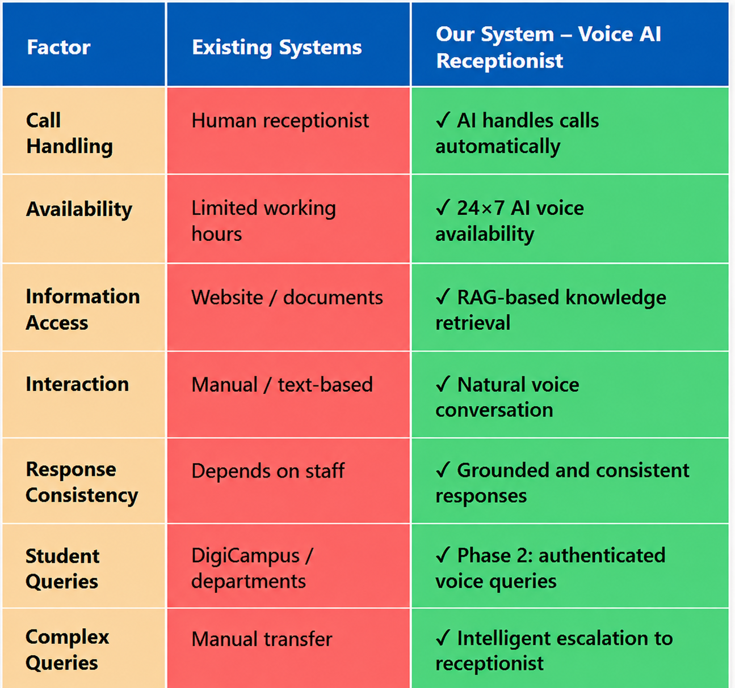
REALTIME CHALLENGES FACED
EXISTING SYSTEMS VS OUR’S
Speech Recognition Handling accents and Tamil-English code-mixed speech.
Low-Latency Processing Maintaining fast STT → RAG → LLM → TTS responses.
Accurate RAG Retrieval Retrieving the correct information from websites and PDFs.
Response Grounding Preventing hallucinations and unsupported answers.
Real-Time Conversation Maintaining context during multi-turn calls.
Telephony Integration Managing live audio streaming and reliable call handling.
Human Escalation Transferring unresolved or sensitive queries smoothly.

Slide 6
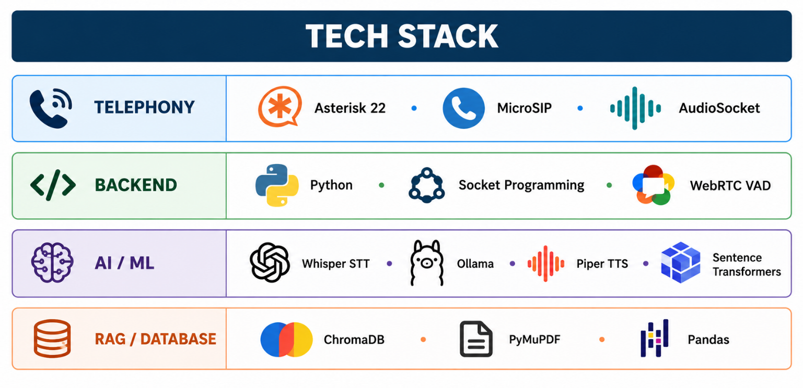
METHODOLOGY
Listen. Retrieve. Respond. Escalate intelligently.
TECH STACK
Collect → Gather college website content, PDFs, circulars, handbooks, and academic information.
Process → Clean and chunk the collected content with relevant source metadata.
Retrieve → Convert chunks into embeddings and store them in ChromaDB for RAG retrieval.
Understand → Convert caller speech into text using Speech-to-Text (STT).
Generate → Retrieve relevant knowledge and use the LLM to generate a grounded response.
Respond → Convert the response into natural speech using Text-to-Speech (TTS).
Continue → Maintain conversation history for multi-turn interactions.
Escalate → Identify unresolved or human-required queries for planned receptionist transfer.
DATA SOURCES
COLLEGE KNOWLEDGE BASE:
REC 2023 UG Regulations
R2023 CSE Curriculum & Syllabus
Certificate for Medium of Instruction
Certificate for CGPA to Percentage Conversion
VECTOR CORPUS:
686 indexed chunks
Sentence-Transformers embeddings
ChromaDB vector store
Caller speaks → Speech is converted to text → Relevant knowledge is retrieved → Grounded response is generated → Response is converted to speech → Caller receives answer → Escalation identified if required
First Review
Department of Computer Science and Engineering
6

Slide 7
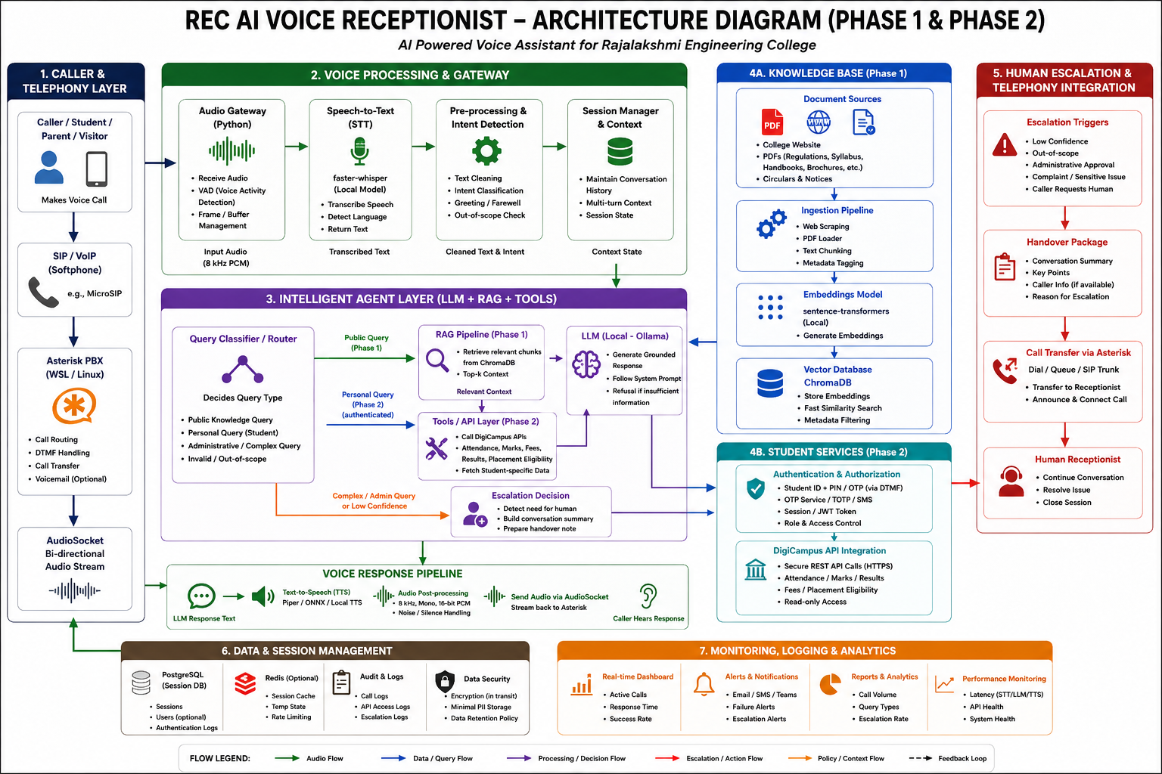
SYSTEM ARCHITECTURE
First Review
Department of Computer Science and Engineering
7

Slide 8
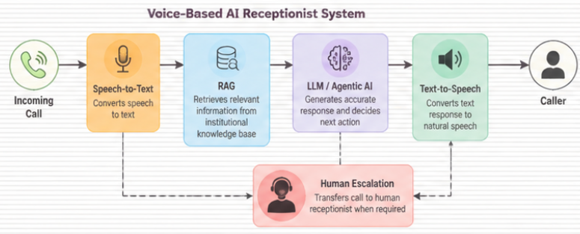
NOVELTY AND KEY INNOVATIONS
USP: An intelligent voice receptionist that combines real-time telephony, speech recognition, RAG-based knowledge retrieval, local LLM reasoning, and planned human escalation for college communication.
Real-Time Voice AI: Handles caller speech through MicroSIP → PJSIP → Asterisk → AudioSocket.
RAG-Based Responses: Retrieves relevant curriculum/document chunks from ChromaDB before generating answers.
Local Speech Recognition: Uses Faster-Whisper for efficient speech-to-text processing.
Context-Grounded LLM: Ollama generates answers using retrieved institutional information.
Multi-Turn Interaction: Maintains conversation context for follow-up questions.
Intelligent Escalation: Identifies unresolved or human-required queries for receptionist transfer.
BUSINESS MODEL:
AI Reception-as-a-Service: Automates routine college inquiries, reduces receptionist workload, and provides 24×7 accessible information support.
First Review
Department of Computer Science and Engineering
8

Slide 9
END-TO-END USE CASE
Use Case Step | Module(s) Involved | Status | Notes
Caller Initiates Voice Call | MicroSIP, Asterisk, AudioSocket | Live | Receives caller audio through SIP telephony.
Speech Recognition | Audio Gateway, VAD, Faster-Whisper | Live | Detects speech and converts caller speech to text.
Knowledge Retrieval | RAG, Sentence Transformers, ChromaDB | Live | Retrieves relevant institutional knowledge.
Grounded Response Generation | Ollama, RAG Pipeline | Live | Generates answers using retrieved college information.
Voice Response | Piper TTS, AudioSocket, Asterisk | Live | Converts response to speech and plays it to caller.
Follow-up Query | Session Context, STT, RAG, LLM, TTS | Implemented / Tested | Maintains context for follow-up questions within the call.
9

Slide 10
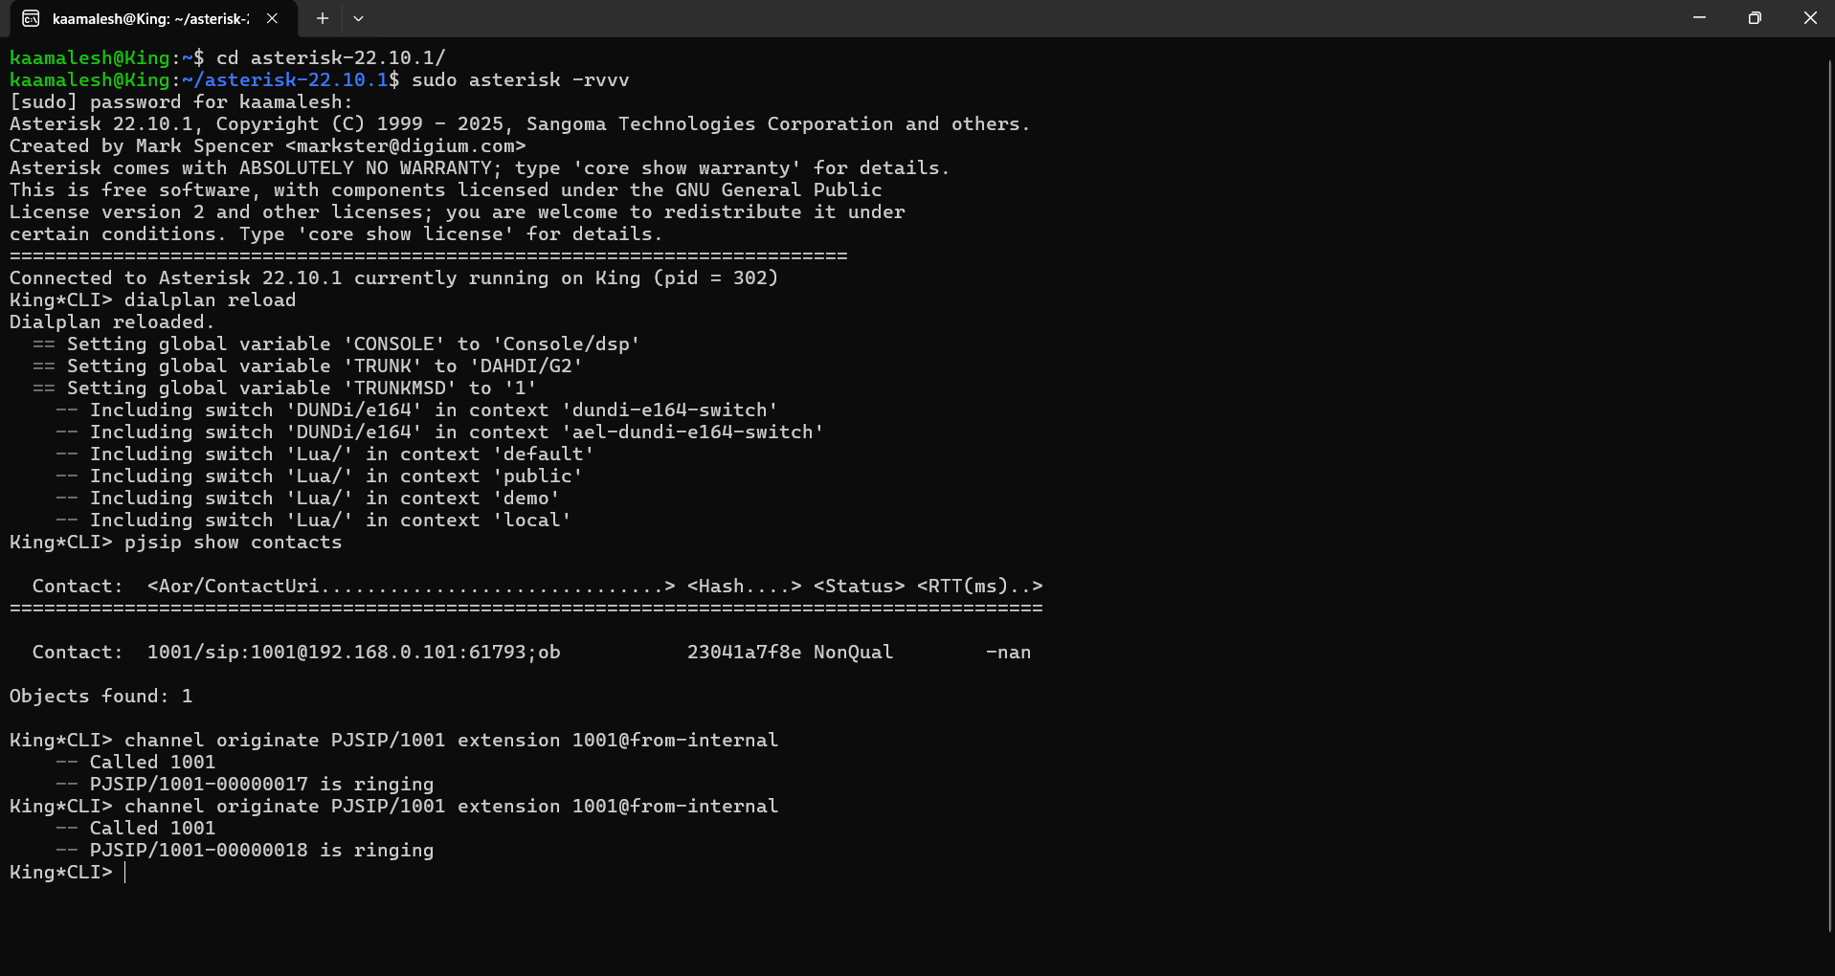
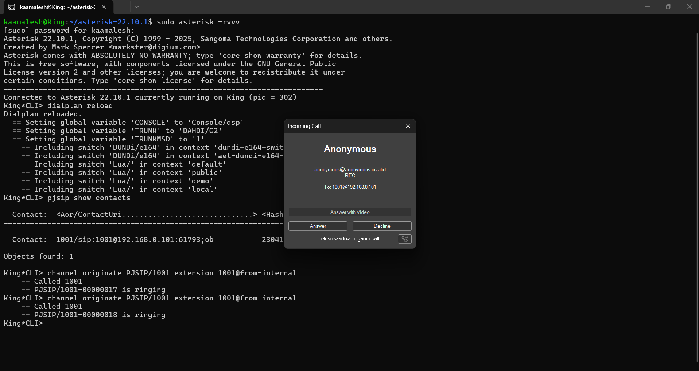
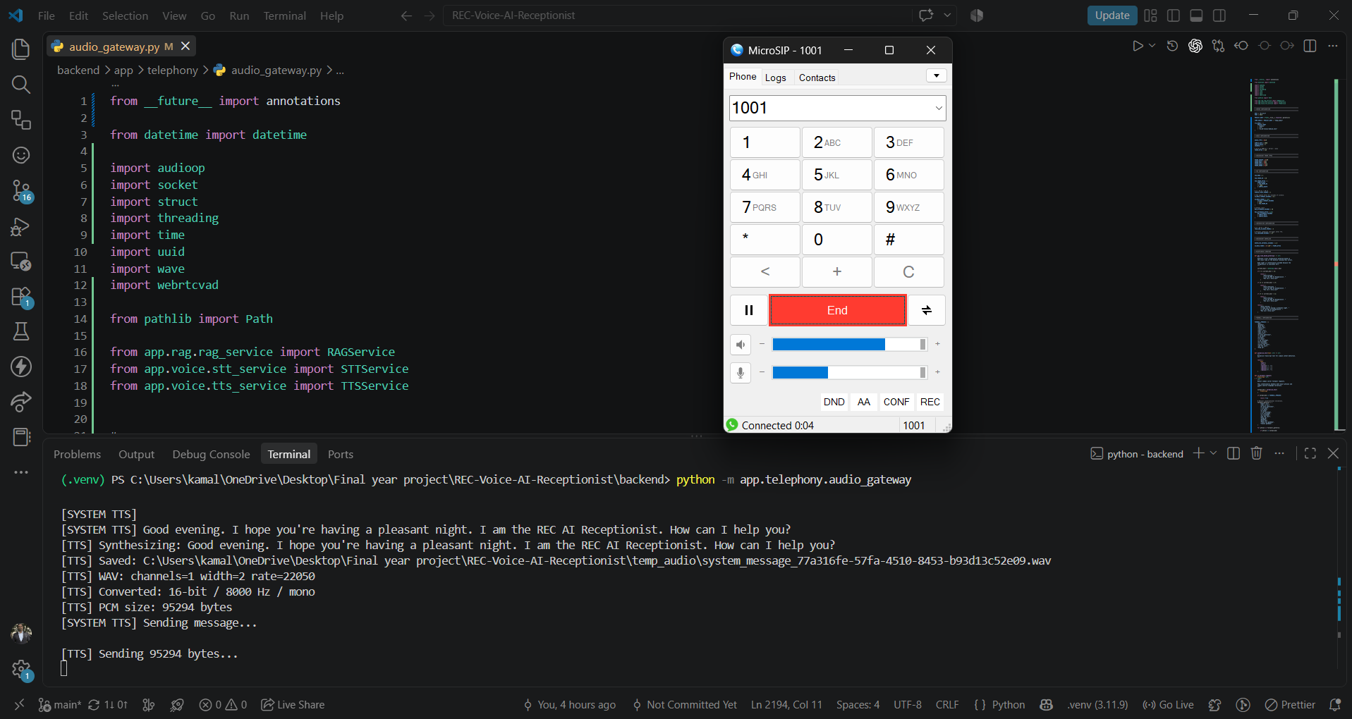
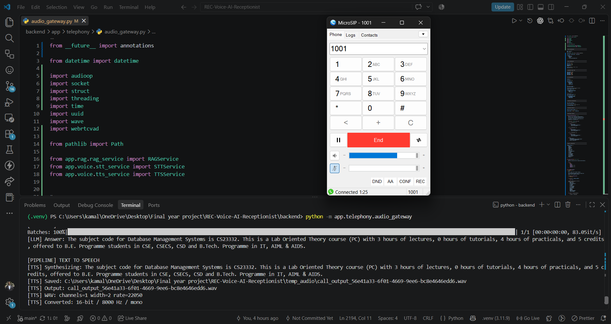
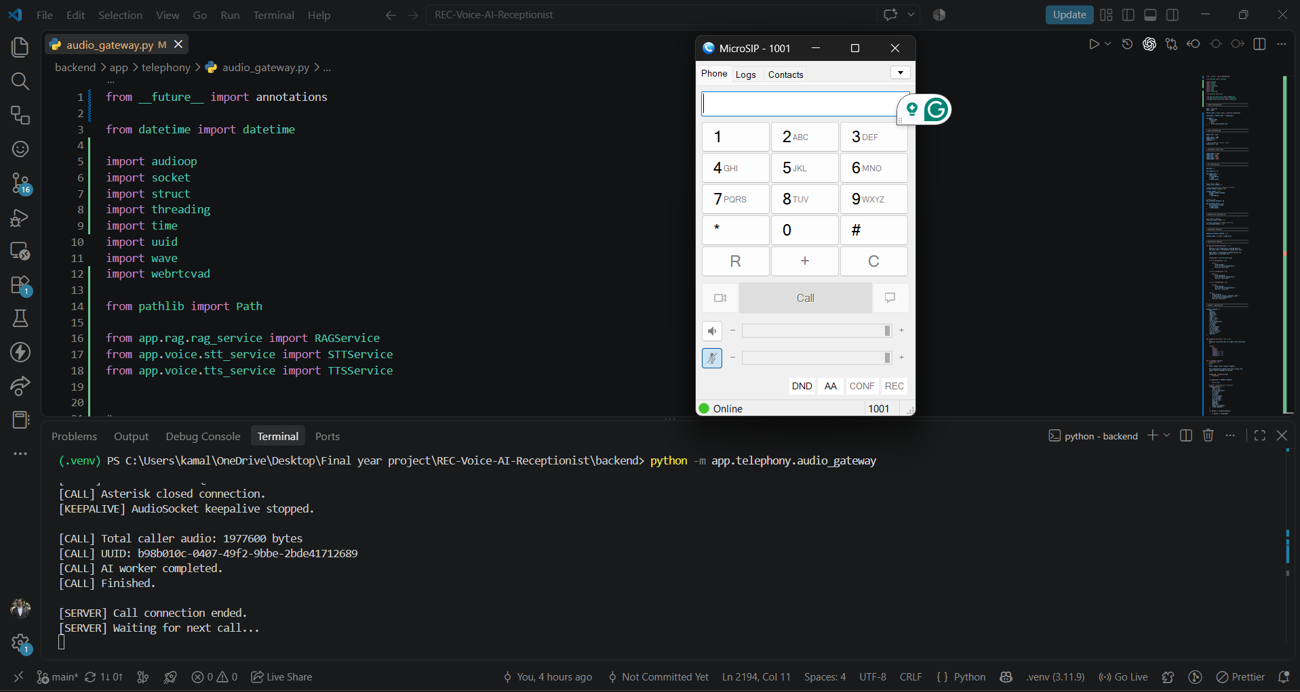
END-TO-END USE CASE – LIVE DEMO
Live call execution demonstrating the implemented Phase-1 voice → RAG → LLM → TTS pipeline.
10

Slide 11
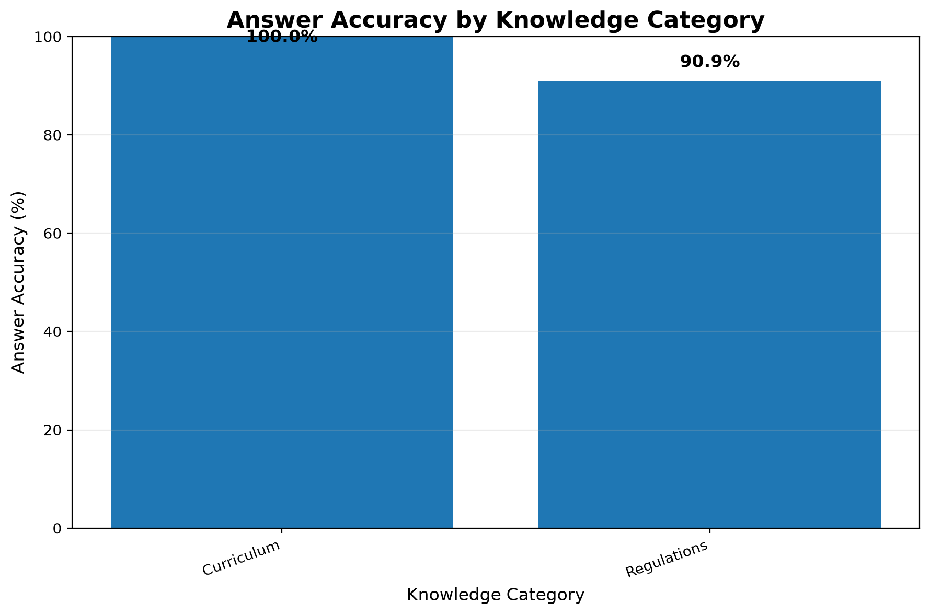
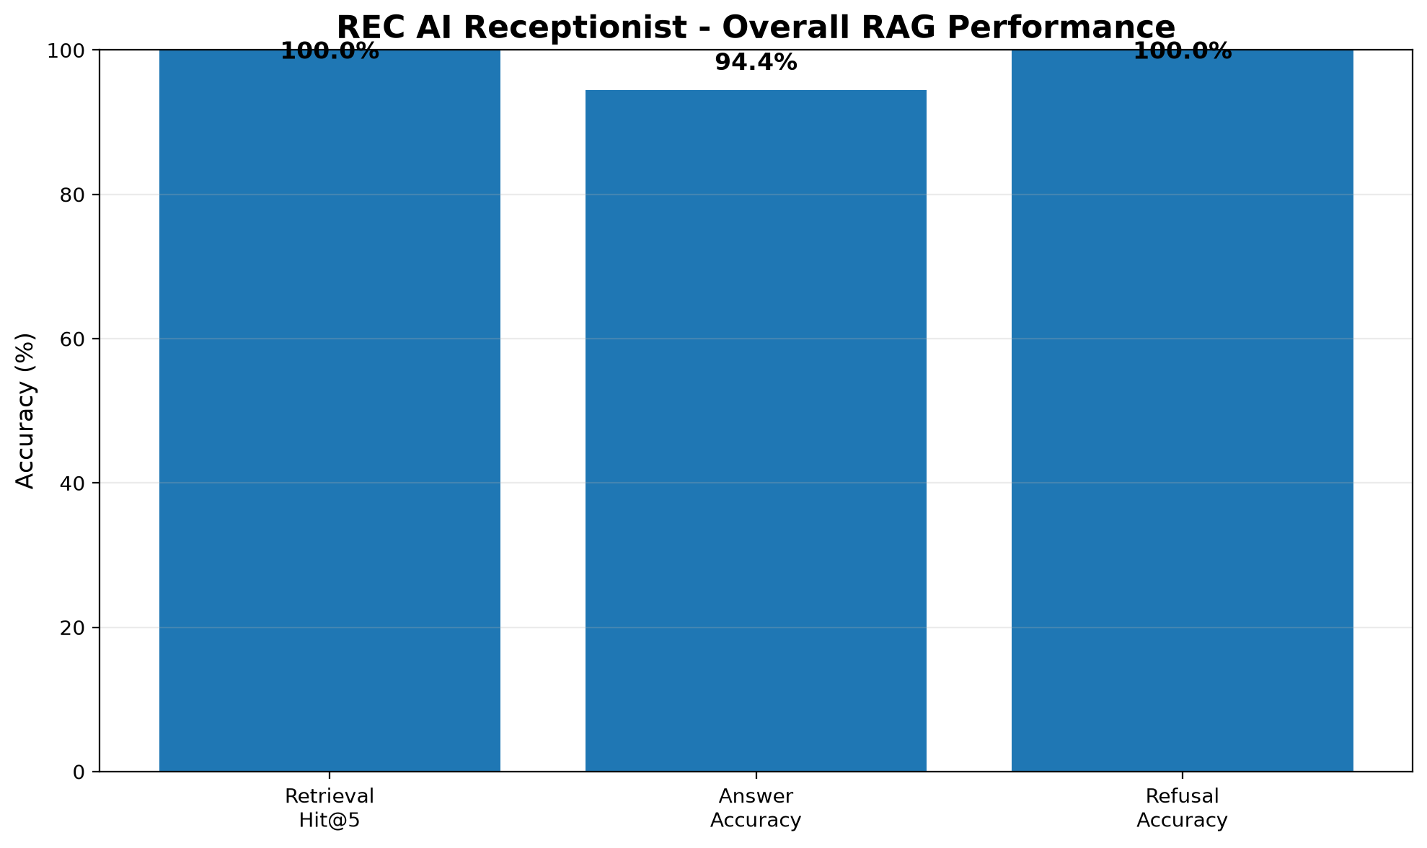
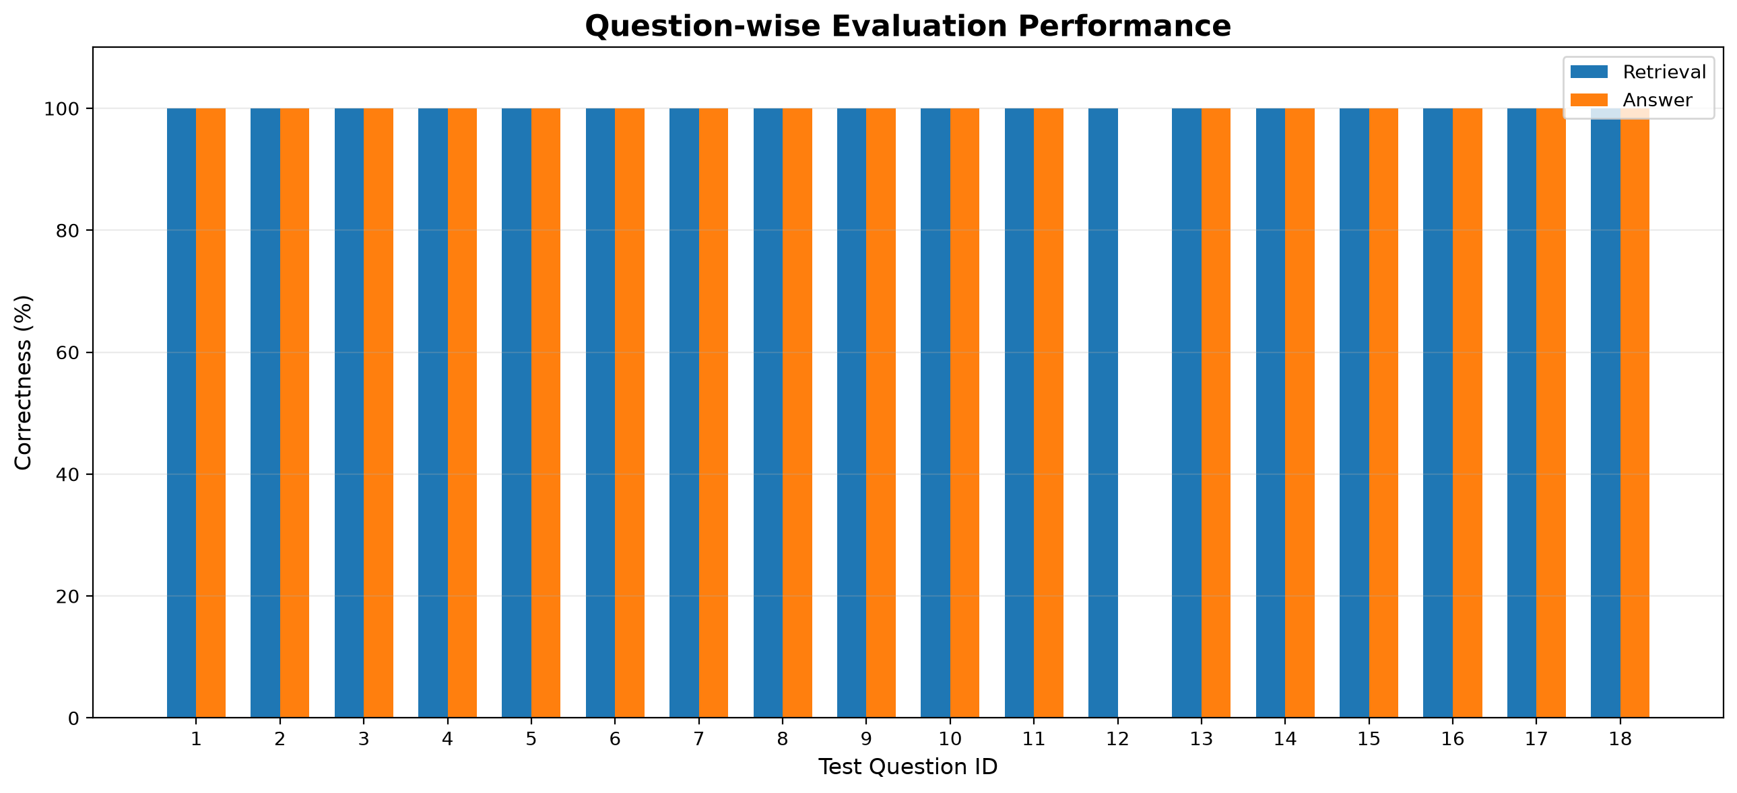
END-TO-END USE CASE – LIVE DEMO
The implemented RAG pipeline was evaluated using 20 test queries. The system achieved 100% Retrieval Hit@5, 94.44% Answer Accuracy on normal queries, and 100% Refusal Accuracy on negative queries.

Slide 12
LITERATURE SURVEY
Author(s) / Year | Title of the Paper | Methodology / Approach | Inference
Alec Radford et al. (2022) | Robust Speech Recognition via Large-Scale Weak Supervision | Whisper encoder-decoder Transformer • Trained using large-scale multilingual and multitask speech data | Demonstrates robust speech recognition across accents, languages, background noise, and different speech conditions, making Whisper suitable for the STT layer of voice applications
Ghayas Ahmed & Aadil Ahmad Lawaye (2023) | End-to-end ASR framework for Indian-English accent: using speech CNN-based segmentation | End-to-end ASR framework • CNN-based speech segmentation • Specifically considers Indian-English accent | Shows the importance of handling Indian-English pronunciation and long-form speech effectively, supporting accent-aware STT evaluation for the proposed receptionist.

Slide 13
LITERATURE SURVEY
Author(s) / Year | Title of the Paper | Methodology / Approach | Inference
Tahir Javed et al. (2023) | Svarah: Evaluating English ASR Systems on Indian Accents | • Indian-English speech benchmark • Evaluated ASR systems | ASR systems require evaluation and improvement for Indian accents.
Shelly Jain et al. (2023) | An Investigation of Indian Native Language Phonemic Influences on L2 English Pronunciations | • Analysed 18 Indian languages • Studied pronunciation variations | Shows that native-language influence affects Indian-English pronunciation and provides useful insights for improving accent robustness in speech systems.

Slide 14
LITERATURE SURVEY
Author(s) / Year | Title of the Paper | Methodology / Approach | Inference
Priyanshi Pal et al. (2023) | Study of Indian English Pronunciation Variabilities Relative to Received Pronunciation | Analysed Indian-English pronunciation variations Developed phonetic rules for ASR/TTS | Demonstrates that Indian-English pronunciation variations should be considered when designing ASR and TTS systems for Indian users.
Munazza Zaib et al. (2022) | Conversational Question Answering: A Survey | Reviews conversational QA systems Covers multi-turn question answering | Establishes the importance of context-aware, multi-turn QA, directly supporting the receptionist's ability to handle follow-up questions during the same call.

Slide 15
LITERATURE SURVEY
Author(s) / Year | Title of the Paper | Methodology / Approach | Inference
Ryan Fellows et al. (2022) | Task-Oriented Dialogue Systems: Performance vs. Quality-Optima, A Review | • Reviews task-oriented dialogue systems • Analyses task resolution and conversational quality attributes | Shows that successful task completion alone is insufficient; conversational quality and user satisfaction are also important for an effective AI receptionist
Vojtěch Hudeček & Ondřej Dušek (2023) | Are Large Language Models All You Need for Task-Oriented Dialogue? | • Evaluates LLMs for multi-turn task-oriented dialogue • Tests interaction with external databases | Finds that LLMs can generate effective task-oriented responses but still have limitations in precise state tracking, supporting the use of controlled retrieval and API-based processing.

Slide 16
LITERATURE SURVEY
Author(s) / Year | Title of the Paper | Methodology / Approach | Inference
Gonçalo Raposo et al. (2023) | Prompting, Retrieval, Training: An Exploration of Different Approaches for Task-Oriented Dialogue Generation | • Compares prompting, retrieval and fine-tuning • Evaluates FLAN-T5, GPT-3.5 and GPT-4 on dialogue datasets | Shows that combining general LLMs with retrieval-based prompting can be effective for task-oriented dialogue, supporting the proposed RAG-based approach.
Shunyu Yao et al. (2022) | ReAct: Synergizing Reasoning and Acting in Language Models | • Combines reasoning and action generation • Allows LLMs to interact with external knowledge sources and environments | Supports intelligent reasoning and actions. Enables interaction with external tools. Provides a basis for Agentic AI.

Slide 17
LITERATURE SURVEY
Author(s) / Year | Title of the Paper | Methodology / Approach | Inference
Timo Schick et al. (2023) | Toolformer: Language Models Can Teach Themselves to Use Tools | • LLM learns when and how to call external APIs • Integrates external tools into language generation | Demonstrates that LLMs can use external APIs for tasks requiring factual lookup and computation, supporting future integration with institutional APIs such as DigiCampus.
Shishir G. Patil et al. (2023) | Gorilla: Large Language Model Connected with Massive APIs | • Fine-tuned LLM for accurate API-call generation • Uses document retrieval with API information | Shows that retrieval-assisted API calling can reduce incorrect tool usage and improve reliability, relevant to secure student-data API access in Phase 2.

Slide 18
LITERATURE SURVEY
Author(s) / Year | Title of the Paper | Methodology / Approach | Inference
Lei Wang et al. (2023) | A Survey on Large Language Model based Autonomous Agents | • Reviews LLM-based autonomous-agent architectures • Studies planning, tool use, applications and evaluation | Provides a broad foundation for designing Agentic AI systems and supports the proposed architecture where the LLM decides whether to answer, retrieve information or invoke an external service
Xiao Liu et al. (2023) | AgentBench: Evaluating LLMs as Agents | • Evaluates LLM agents across eight interactive environments • Measures reasoning and decision-making abilities | • Agent behaviour requires proper evaluation. • Highlights reasoning limitations. • Supports controlled agent design.

Slide 19
LITERATURE SURVEY
Author(s) / Years | Title of the Paper | Methodology / Approach | Inference
Shi-Qi Yan et al. (2024) | Corrective Retrieval Augmented Generation | • Retrieval-quality evaluator • Corrective retrieval actions • Filters irrelevant retrieved information | Shows that evaluating retrieval quality before generation can improve RAG robustness, supporting confidence-based answering and escalation when reliable information is unavailable.
Shahul Es et al. (2024) | RAGAs: Automated Evaluation of Retrieval Augmented Generation | • Reference-free RAG evaluation • Measures retrieval relevance, generation quality and faithfulness | Provides a practical framework for evaluating the proposed RAG pipeline, particularly for measuring whether responses are grounded in retrieved college information.

Slide 20
LITERATURE SURVEY
Author(s) / Year | Title of the Paper | Methodology / Approach | Inference
Yunfan Gao et al. (2024) | Retrieval-Augmented Generation for Large Language Models: A Survey | • Reviews Naive, Advanced and Modular RAG • Analyses retrieval, augmentation and generation components | Establishes RAG as an effective approach for reducing hallucination and incorporating domain-specific, updatable knowledge into LLM applications.
Akari Asai et al. (2024) | Self-RAG: Learning to Retrieve, Generate, and Critique through Self-Reflection | • Adaptive retrieval • Generation with self-reflection • Critiques retrieved evidence and generated responses | Self-reflection improves factuality Supports better response grounding , Improves retrieval and generation quality.

Slide 21
Thank You
21

